Slide 1

Custom IDA Azure SQL Sidharth Bansal Employee Id : 655314

Slide 2
Day 1 28th August
Basics of SQL
12 Codd’s Rule
Practical Application of Codd’s Rule
Attributes and types in SQL
Entities and Types
Explanation of DDL,DML,DQL,DCL and TCL
Normalization
Er diagrams

Slide 3
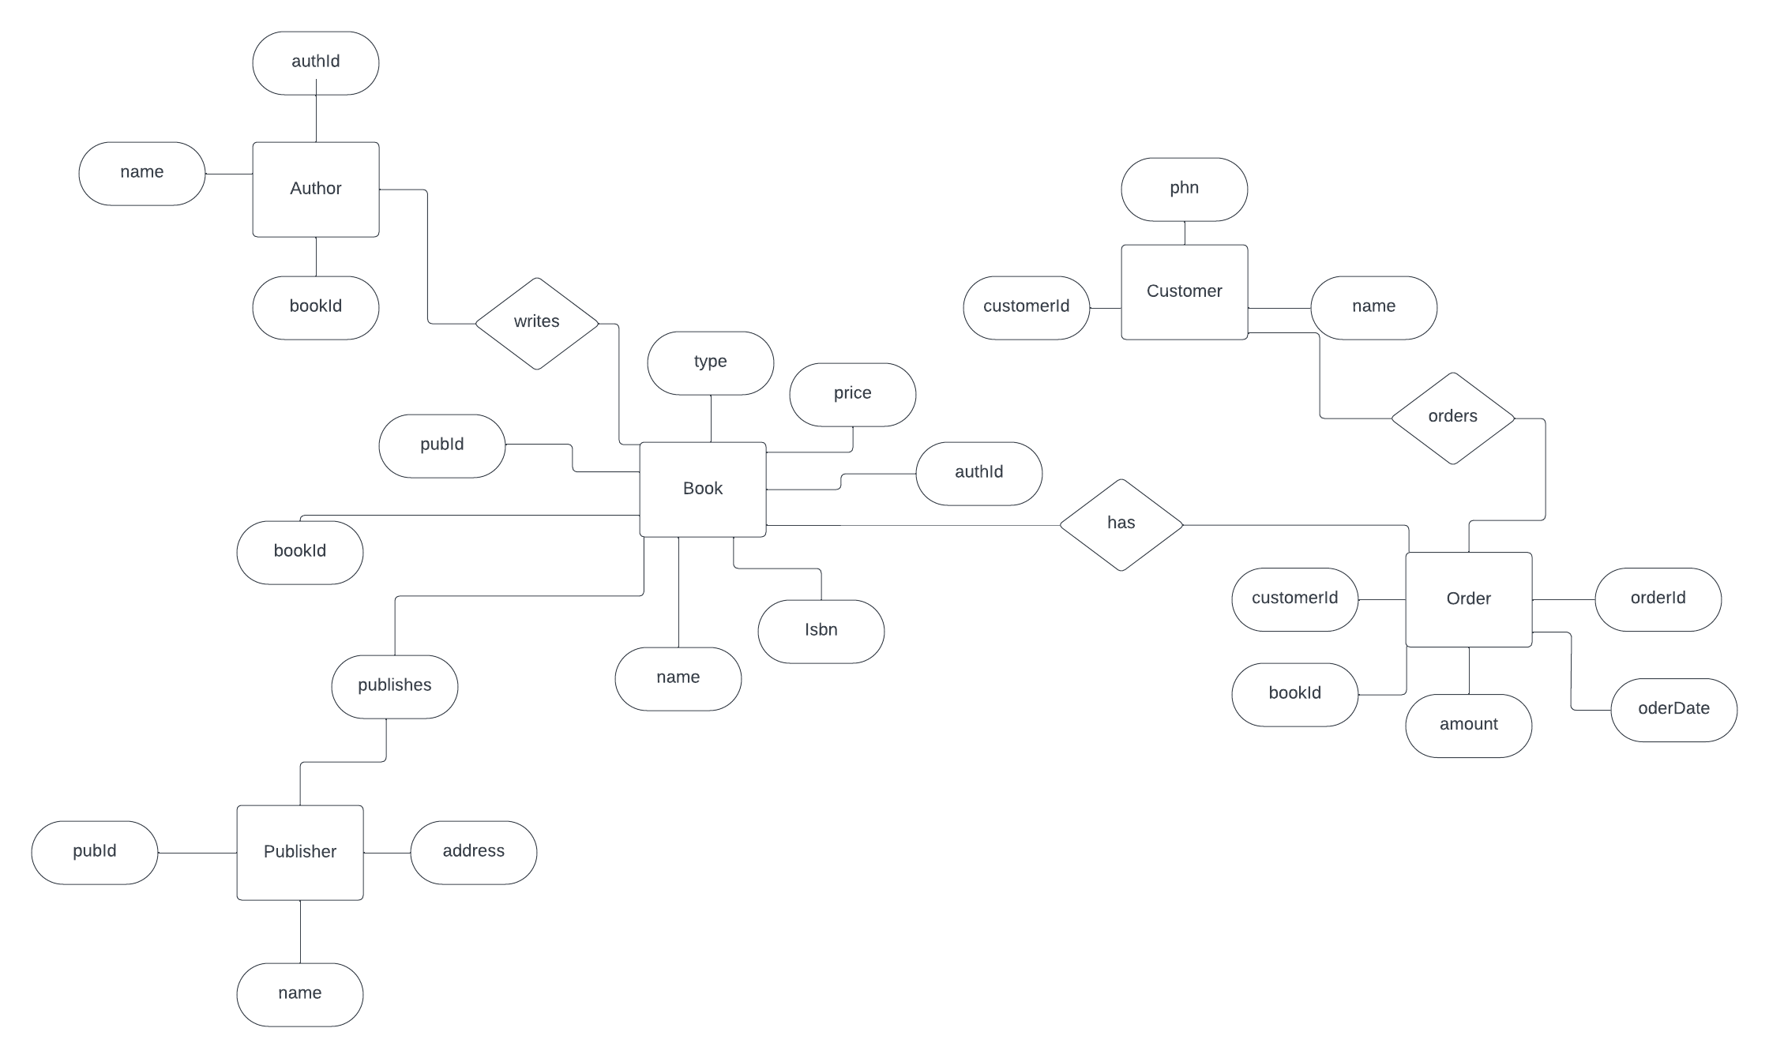

Slide 4
Day 2 29th August
Definition of Datawarehouse
Difference between Datawarehouse and Database
Advantages of using Datawarehouse
Introduction of RCD,SCD and UCD
Dimension Table hands on creation
Hands on SCD1,SCD2 and SCD3
Big Data 7 V’s
Challenges of Big Data
Big Data Architecture
HDFS Introduction

Slide 5
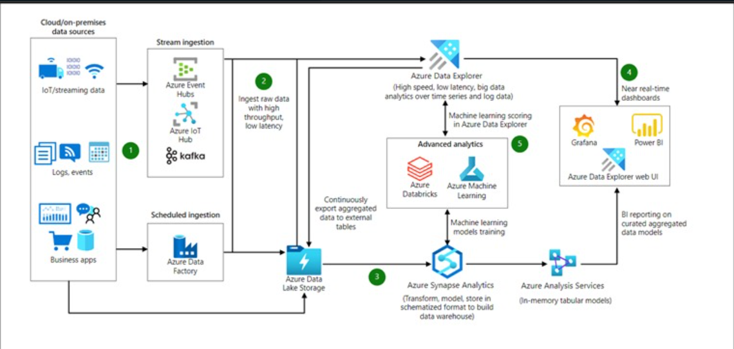

Slide 6
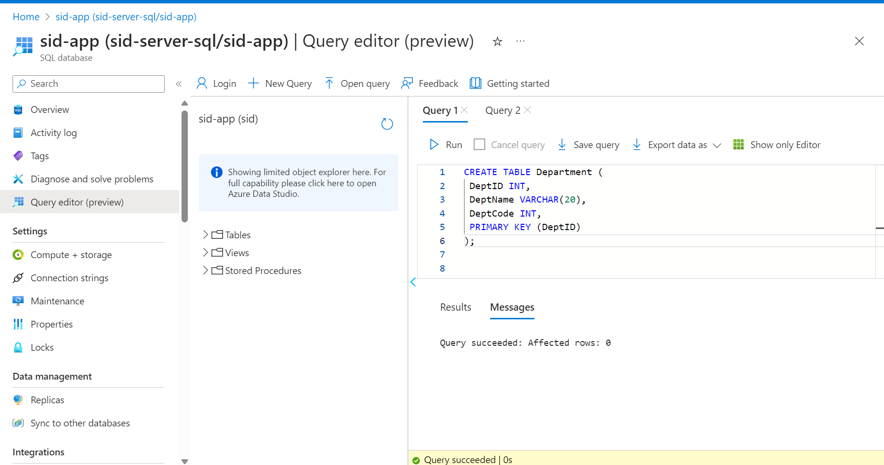
Day 3 30th August
Introduction about Data lake,Azure HD Insight,Azure DataLake store and Azure Data lake analytics
Basics of Azure Sql
Hands on with SQL clauses like SELECT,WHERE,CREATE TABLE,INSERT

Slide 7
Day 4 31st August
Hands on with Aggregators functions SUM(),AVG(),COUNT(),MAX() and MIN()
Learned about JOINS like INNER,LEFT,RIGHT and FULL
Intro to basic sub queries
Used constraints like Primary Key and Foreign Key while creating tables
Used Having By and Order By

Slide 8
Day 5 1st September
Hands on JOIN queries
Correlated sub queries
Hands on with RANK() function using Partition
Introduction to indexes in SQL
Hands on Stored Procedure Creation
Created VIEW
Advantages of VIEW

